Slide 1
AI VS. HUMAN : ACADEMIC ESSAY AUTHENTICITY CHALLENGE
PIP2001 Capstone Project
Final viva voice
Batch Number: PSCS180
Under the Supervision of,
Prof. Sandhya L
Assistant Professor
School of Computer Science and Engineering
Presidency University
STUDENT NAME | ROLL NUMBER
MANJUNATH REDDY | 20211CST0043
MALLIKA | 20211CST0002
HARI NARAYANA | 20211CST0029
RAKSHITHA M | 20211CST0050
Roll Number | Student Name
Name of the Program:
Name of the HoD: Dr.Saira bhanu
Name of the Program Project Coordinator: Dr. H M Manjula
Name of the School Project Coordinators: Dr. Sampath A K / Dr. Abdul Khadar A / Mr. Md Ziaur Rahman

Slide 2
Introduction
This project focuses on addressing the increasing use of AI tools in generating essays, particularly in educational contexts, where maintaining academic integrity is crucial. The aim of the system is to classify essays as either machine-generated or human-authored. The system is capable of identifying texts generated by various large language models, such as ChatGPT, and determining whether the content is AI-generated (Fake) or written by a human (Real). This binary classification task extends to essays written by both native and non-native speakers in two languages: English.

Slide 3
Literature Review
Paper Name | Author(s) | Limitations | Advantages | Disadvantages
(The Rise of AI in Content Generation 2019) | Radford | Focused mainly on transformer architecture without addressing practical applications. | Introduced transformer-based architectures that improved text generation. | Limited focus on challenges in academic settings and authenticity.
Challenges in Distinguishing AI-Generated Text (2019) | Zellers | GPT-2 detection model was not robust across diverse texts and contexts. | Highlighted the difficulty in distinguishing between AI-generated and human text. | Struggled with high false positive rates in detection.
Challenges in Distinguishing AI-Generated Text . (2020 | Brown | Detection remains imperfect, especially for advanced models like GPT-3. | Demonstrated significant improvement in text fluency with GPT-3. | The increased fluency of models like GPT-3 complicates detection.
Existing Detection Techniques (2020) | Bakhtin | Detection models like RoBERTa are still limited to certain text structures. | RoBERTa-based detectors show reasonable accuracy in distinguishing AI text. | May not detect subtle, sophisticated AI-generated content.

Slide 4
Existing Detection Techniques . (2020) | Ippolito | The study's models might not generalize well to highly diverse writing styles. | Focused on context, sentence structure, and stylistic patterns for better accuracy. | Models might fail in detecting new or evolving AI writing styles.
Multilingual Detection . (2021) | Elmadany . | AI detection is inconsistent in low-resource languages like Arabic. | Extended AI detection research into multilingual contexts, particularly Arabic. | Limited to specific languages, making global application difficult.
Impact on Academic Integrity . (2021) | Kovačević | Some detection systems still generate false positives, affecting fairness. | Highlighted the growing concern of AI in academic environments. | May result in unfair detection of legitimate student work.

Slide 5
Research Gaps Identified
Area of Concern | Key Issues | References
1. Authorship Dynamics and Creative Expression | - Redefinition of authorship and voice in AI-assisted writing. - Traditional frameworks assume human authorship, overlooking AI contributions to identity and voice. | Ivanič (1998), Tardy (2012)
2. Ethical and Integrity Concerns | - Unclear if AI-generated content constitutes plagiarism. - Lack of guidelines on acceptable levels of AI assistance. - Challenges in distinguishing legitimate use from misuse | Peacock and Flowerdew (2001)
3. Technological Limitations and Operational Challenges | - AI tools struggle with nuanced contexts and specialized fields. - Inability to consistently meet academic rigor. | Riedl (2016), Bender et al. (2021)
4. Pedagogical Implications and Educational Strategies | - Potential to aid brainstorming and revising. - Risks diminishing independent learning and critical thinking. - Lack of research on long-term impacts on learning.
5. Genre-Specific Challenges and Linguistic Intricacies | - Limited genre-specific analysis of AI-generated texts. - Challenges in meeting precision for scientific writing or nuanced argumentation for humanities. | Fyfe (2023)

Slide 6
Proposed Methodology
We outline the methodology for developing an AI-driven plagiarism detection system tailored to identify content generated by language models. The proposed system leverages advanced natural language processing (NLP) techniques and statistical analysis of text patterns to assess the originality of textual inputs. This methodology focuses on the concepts of perplexity and burstiness, which are key metrics for distinguishing human-written content from AI-generated text.

Slide 7
Objectives
To address the limitations of existing AI-generated text detection systems, this project proposes a robust method designed to improve accuracy, adaptability, and scalability. The key components of the proposed method are as follows:
Use of the Roberta-Base-OpenAI-Detector Model
User-Friendly Interface with Dash
Adaptive Model Training
Login and signup pages with correct connectivity to database

Slide 8
System Design & Implementation
1.System Overview:
The AI plagiarism detection system is designed to analyze textual content and determine whether it is human-written or AI-generated. The system leverages advanced natural language processing (NLP) techniques and statistical metrics such as perplexity and burstiness to identify patterns indicative of AI-generated text.
2.Architecture:
The architecture of the system is modular, consisting of several layers to ensure scalability and maintainability.
3.Tools and Technologies Used:
Python
Transformers
NLTK
Streamlit
Plotly
PyTorch

Slide 9
4. Implementation Steps:
Setting Up the Environment
Data Preprocessing
Perplexity Calculation
Burstiness Analysis
5.System Workflow:
User Input
Data Processing
Analysis
Results and Visualization

Slide 10
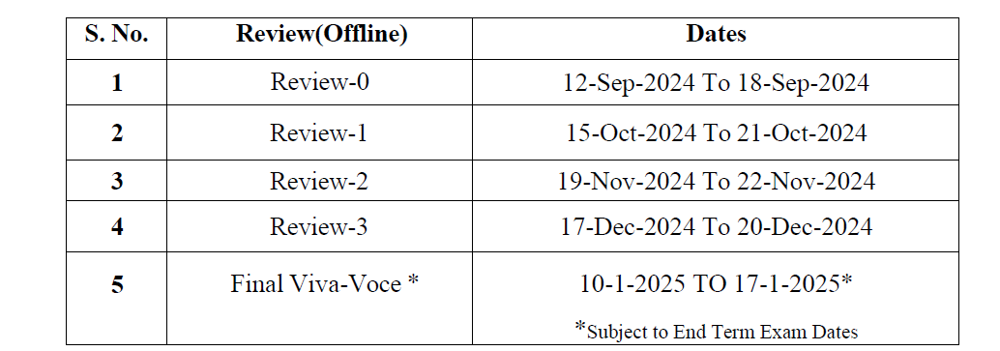
Timeline of Project

Slide 11
Outcomes / Results Obtained
The proposed system is expected to yield several important outcomes that will contribute to safeguarding academic integrity and ensuring the authenticity of written content in educational settings:
Improved Detection Accuracy
User-Friendly Interface
Scalable Solution for Large Institutions
Explainable and Transparent AI

Slide 12
Conclusion
This project offers a robust solution for detecting AI-generated essays, ensuring academic integrity by distinguishing between human and machine-authored texts. Utilizing the Roberta-base-openai-detector model, it provides accurate classification with support for both English and Arabic essays. The user-friendly interface and explainability features enhance accessibility and transparency, while the system’s adaptability ensures it remains effective against evolving AI models. By promoting ethical AI use in education, this tool will help institutions maintain fair academic practices and uphold authenticity in student work.

Slide 13
References
[1] R. Corizzo and S. Leal-Arenas, "A Deep Fusion Model for Human vs. Machine-
Generated Essay Classification," IEEE, 2023.
[2] W. H. Pan, M. J. Chok, J. L. S. Wong, Y. X. Shin, Z. Yang, Y. S. Poon, C. Y.
Chong, D. Lo, and M. K. Lim, "Assessing AI Detectors in Identifying AIGenerated
Code: Implications for Education," IEEE, 2024.
[3] V. Pandita, A. M. Mujawar, T. Norbu, V. Verma, and P. Patil, "Text Origin
Detection: Unmasking the Source – AI vs Human," IEEE , 2024.
[4] D. Yan, M. Fauss, J. Hao, and W. Cui, "Detection of AI-generated Essays in
Writing Assessments," Psychological Test and Assessment Modeling, vol. 65,
2023.
[5] X. Peng, Y. Zhou, B. He, L. Sun, and Y. Sun, "Hiding the Ghostwriters: An
Adversarial Evaluation of AI-Generated Student Essay Detection,"
arXiv:2402.00412v1 [cs.CL], Feb. 2024.

Slide 14
Thank You

